Slide 1

DATABASE
CONPREHENSIVE
李文杰 林津好 韩婉霞
Kim sihyo
Sim jaehawn

Slide 2

INDEX
Introduce
Create Table
Drop Table

Slide 3
01
Introduce

Slide 4
Contents
Prior to the program description, I will explain Create Table and Drop table first.
First, The CREATE TABLE statement is used to create a new table in a database.
CREATE TABLE table_name ( column1 datatype, column2 datatype, column3 datatype, .... );
The column parameters specify the names of the columns of the table.
The datatype parameter specifies the type of data the column can hold.
(e.g. varchar, integer, date, etc.)

Slide 5
Contents
CREAT TABLE example
The following example creates a table called “Student" that contains five columns
PersonID, LastName, FirstName, Address, and City:
CREATE TABLE Persons ( StudentID int, LastName varchar(255), FirstName varchar(255), Address varchar(255), School varchar(255) );
The StudentID column is of type int and will hold an integer.
The LastName, FirstName, Address, and School columns are of type varchar and
will hold characters, and the maximum length for these fields is 255 characters.

Slide 6
Contents
Create Table Using Another Table
CREATE TABLE new_table_name AS
SELECT column1, column2,...
FROM existing_table_name
WHERE ....;
A copy of an existing table can be created using a combination of the
CREATE TABLE statement and the SELECT statement.
The new table gets the same column definitions.
All columns or specific columns can be selected.
If you create a new table using an existing table,
the new table will be filled with the existing values from the old table.

Slide 7
Contents
Second, The DROP TABLE statement is used to drop existing table in a database.
DROP TABLE table_name ;
Be careful before dropping a table.
Deleting a table will result in loss of complete information stored in the table!
The TRUNCATE TABLE statement is used to delete the data inside a table.
TRUNCATE TABLE table_name ;
DROP statement is the deletion of the entire TABLE.
But TRUNCATE statement is the difference in the deletion of data in TABLE.

Slide 8
02
Create Table

Slide 9
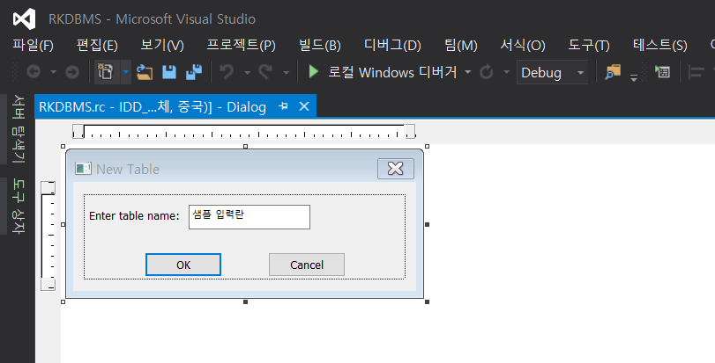
Contents
Input
Read the "ruanko.db" file,
access to database folder path of the default database "Ruanko".
(2) Users select "table-> create table" via the menu,
and input table name in the pop-up dialog box CNewTableDlg.

Slide 10
Contents
Process
Create database table description file “[DBMS_ROOT]\data\Ruanko\Ruanko.tb”
(2) Save the table description information to the “Ruanko.tb”file.
Output
Generate "Ruanko.tb" document, and write table information.
(2) In the tree view CDBView, add a child node HTREEITEM,
and display the table name.

Slide 11
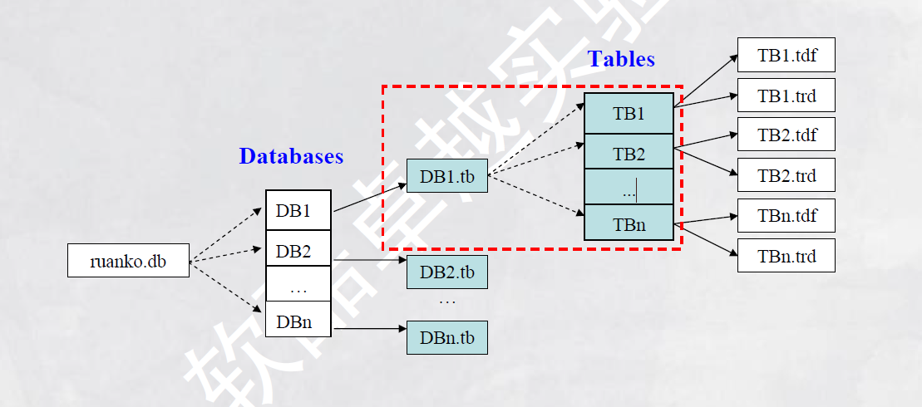
Contents
Create a database table description file Ruanko.tb according to the database name
Ruankoto save the table information in the database.
By reading the table description file (Ruanko.db),
we can find the table structure definition file (*.tdf)and data record file (*.trd).

Slide 12
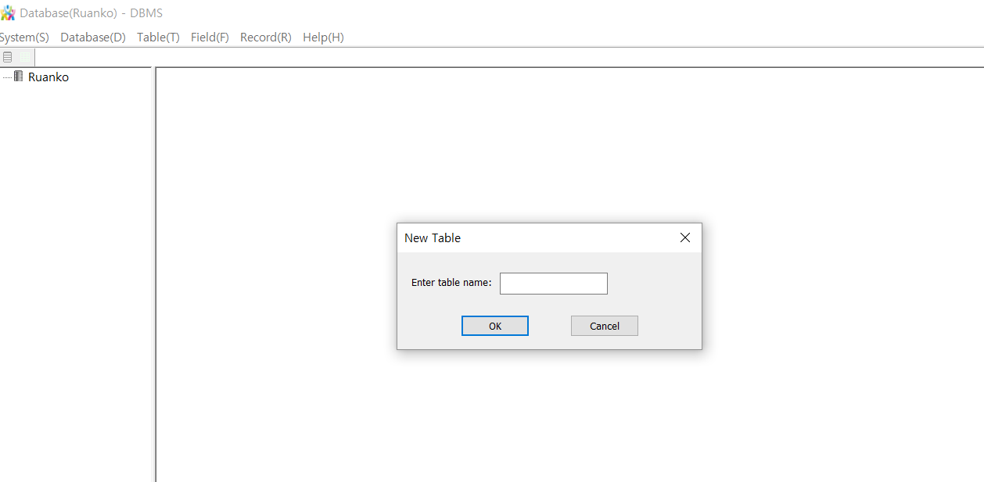
Contents
Create a dialog box CNewTableDlgfor entering table name,
and add message response function CMainFrame::OnNewTable()to the menu
“table ->create table”, then will popup this dialog box after click it.
Dialog box design
Create dialog box CNewTableDlg, and receive user input’s table name by
edit box control. Confirm the entered table name by OK button.

Slide 13
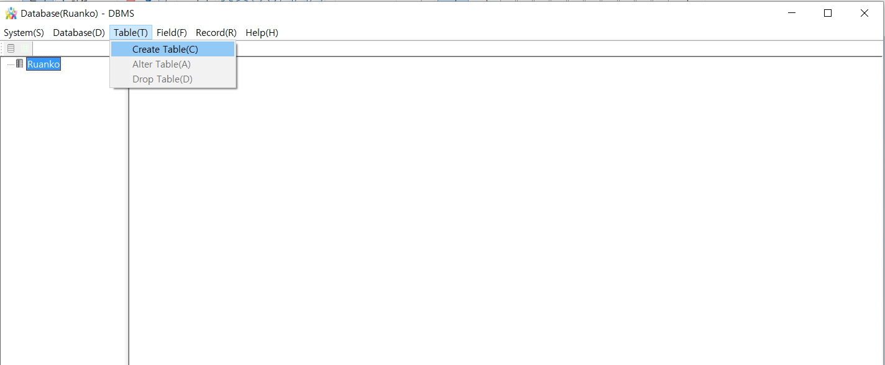
Contents
(2) Menu
Add COMMAND message response function CMainFrame::OnNewTable()
to the menu of “table ->create table

Slide 14
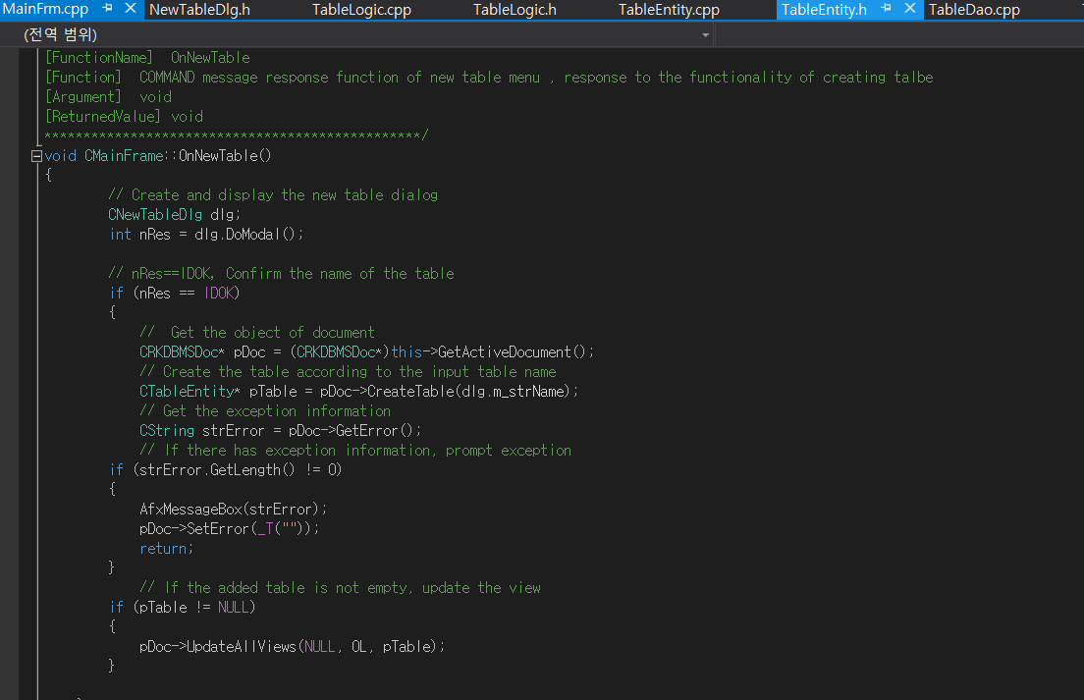
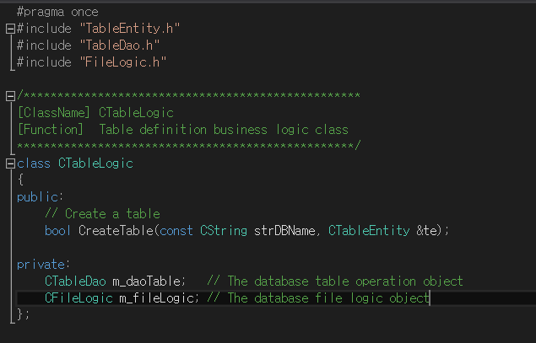
Contents
Data transfer
Frame class CMainFrame get table name and transfer to the document class
CRKDBMSDoc::CreateTable() function, then call the logic class
CTableLogic of CreateTable() function to create the database.

Slide 15
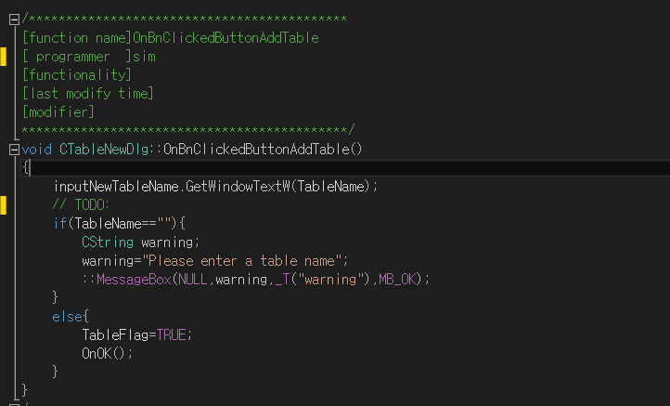
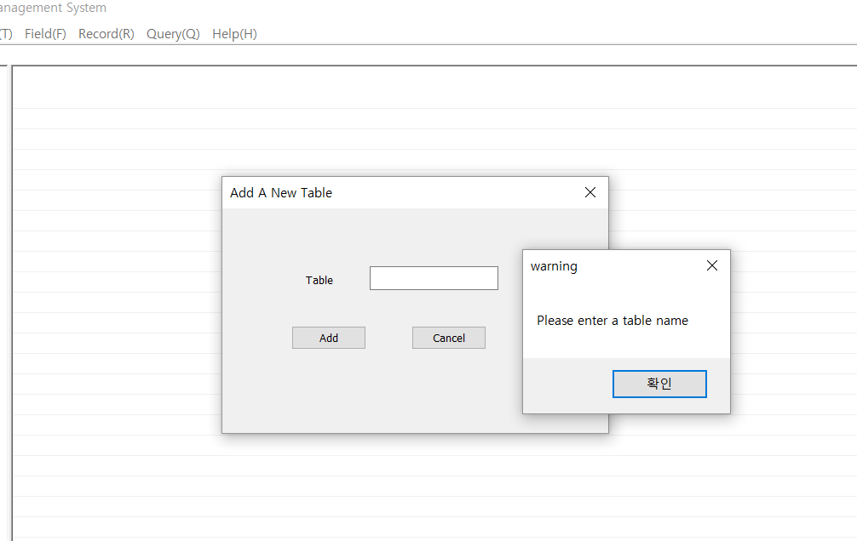
Contents
New Table
If you do not enter the name of the table, then this warring text appears.

Slide 16
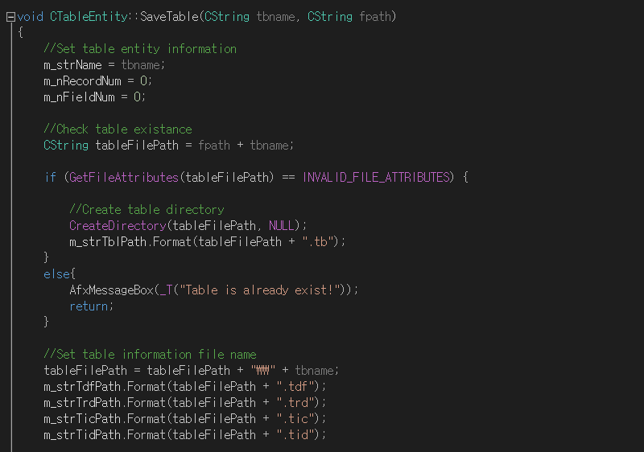
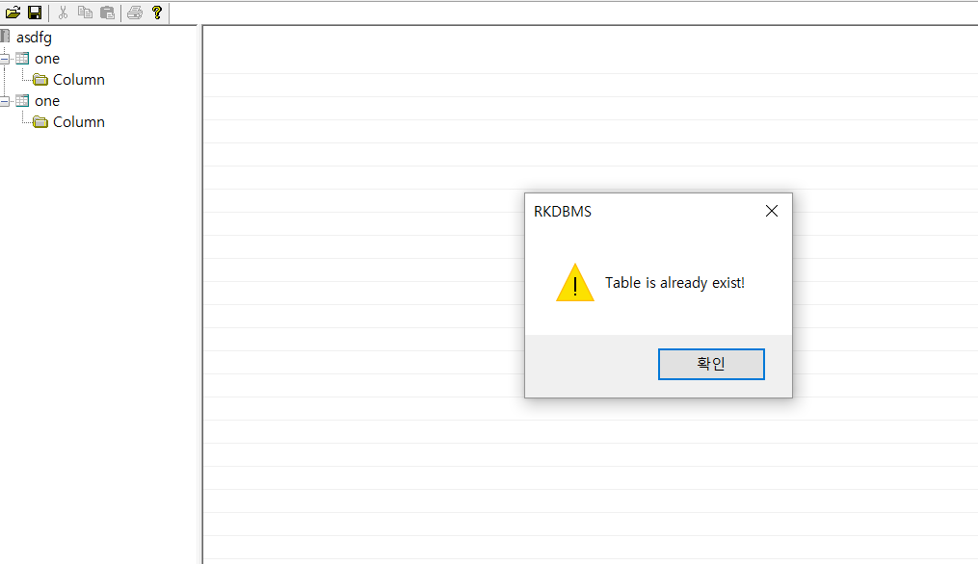
Contents
New Table
If you do enter the same name of the table, then this warring text appears.

Slide 17
03
Drop Table

Slide 18
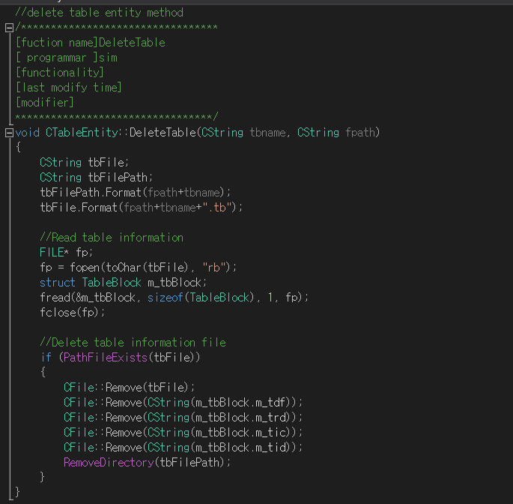
Contents
Drop Table
Implement database table deletion function.
Corresponding SQL statement: DROP TABLE <table name>.

Slide 19
Thank you

